Slide 1
Chrome plugin – To manage the site settings

Slide 2
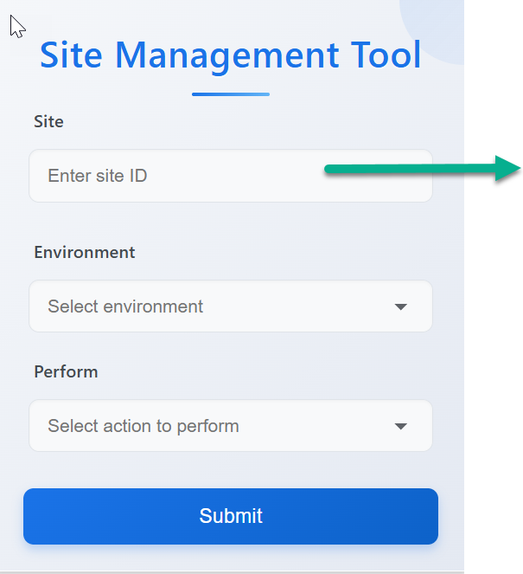
You can enter the site ID here

Slide 3
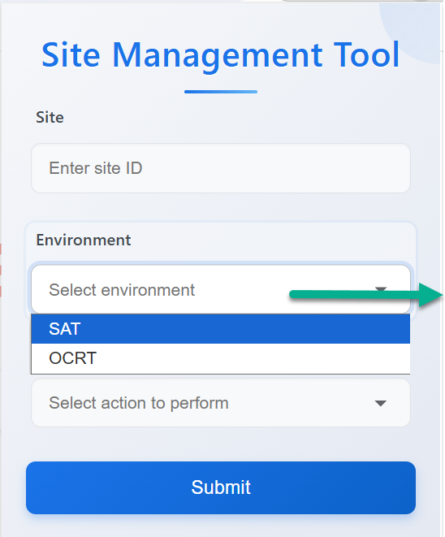
You can manage the site settings only for the below environments,
SAT
OCRT

Slide 4
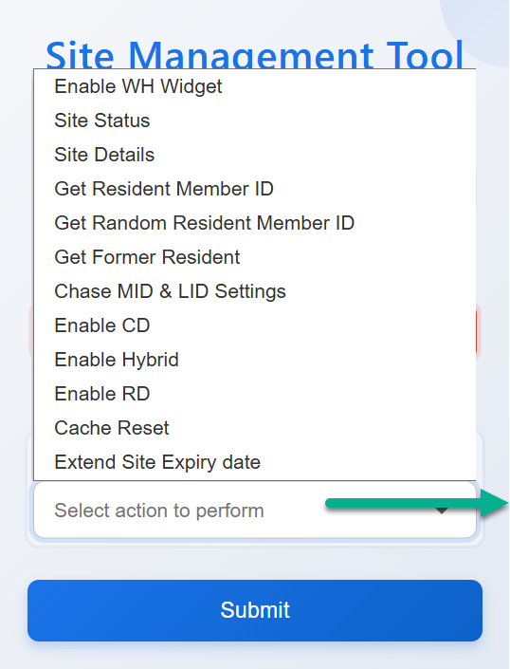
You can perform the actions (available on dropdown) for the site to set in this plugin.

Slide 5
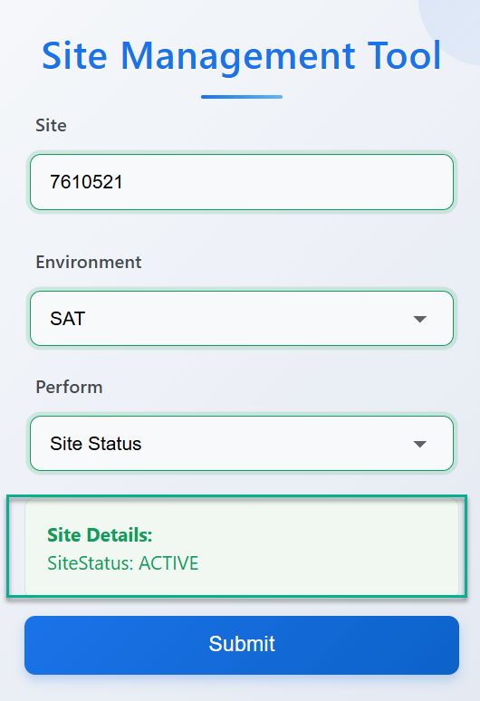
Displays in green, if the response is successful

Slide 6
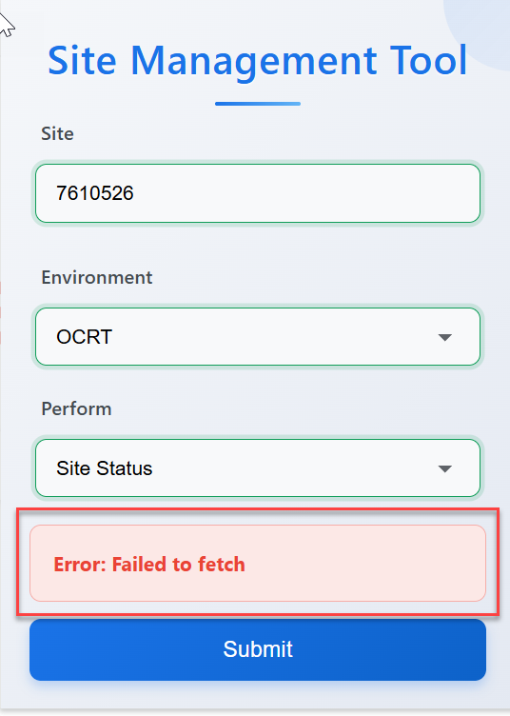
Displays in RED, and the error when request failed to fetch!!
Request failed to fetch for below reasons,
If any details provided are mismatched
If any query/ API issues

